Slide 1
Responsive Design, Troubleshooting, & Media Queries
Front-End Web Development

Slide 2
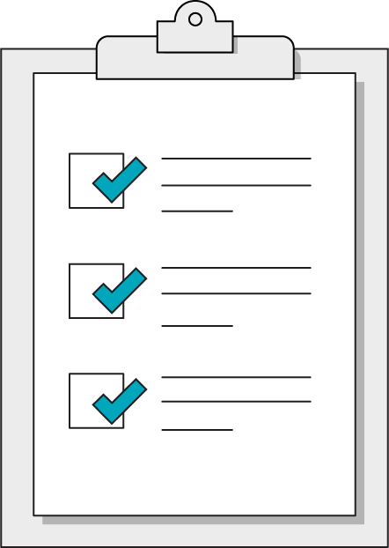
Today’s Learning Objectives
In this lesson, you will:
Review responsive design through troubleshooting
Use media queries to create print-friendly layouts
Use JavaScript to trigger CSS animations.
‹#› | © 2020 General Assembly

Slide 3
Troubleshooting
Front-End Web Development

Slide 4
The Bad Intern Plays Chicken
60 Minutes
The bad intern has been given another chance and has blown it! The client is a large e-commerce company specializing in agricultural products and your firm has designed a new product page. Fix the intern’s mistakes!
Starter code:
https://drive.google.com/drive/folders/1_NewAC9XrQxWxt47fAKccetf5pRUdSkI?usp=sharing
Solution code:
https://drive.google.com/drive/folders/1xCDNN_7NP2hNR2J243JfHEe_vZ5zQhIH?usp=sharing
‹#› | © 2020 General Assembly

Slide 5
Media Queries Again
Front-End Web Development

Slide 6
The Media Query
.text-design {
font-size: 18px;
}
@media (min-width: 480px) {
.text-design {
font-size: 24px;
}
}
Target a min-width with @media and provide property/value pairs inside of the current style sheet. The code really is this easy but there’s more to consider.

Slide 7
Media Types
Typically, all you would use is the screen type. Many sites leave it out altogether now.
Media Type | Description
all | Suitable for all devices
print | Styles for printed documents
screen | Phones, tablets, TV, watches, computers
speech | Screen readers for accessibility

Slide 8
Media Features (abridged)
There are a handful of targetable features that we regularly use. There are a lot more that are almost never used.
Media Type | Description
width | Suitable for all devices
height | Styles for printed documents
orientation | Phones, tablets, TV, watches, computers

Slide 9
The Printed Word
60 Minutes
CSS is not just for screen display. This invoice for an e-commerce website needs to be tuned for print. Eliminate all unnecessary page elements and re-tune the page to print.
Starter code:
https://drive.google.com/drive/folders/1wQv2aYGyfmDT65LuCKHRzoIYeCNVgaXc?usp=sharing
Solution code:
https://drive.google.com/drive/folders/1umaaRgfHwvKU7Ftle0WhoKyh3glDZjBa?usp=sharing
‹#› | © 2020 General Assembly

Slide 10
Enrichment: Animation
Front-End Web Development

Slide 11
Three Types of Animation
We’re going to cover three animation techniques in this lesson:
Simple: transition property with the :hover pseudo-class.
Changes the background color of a button when the user hovers over it.
Less Simple: animation property with the @keyframes rule.
Moves an element on the page with animation.
JavaScript: Switch application state with .classList.toggle().
Triggers an off-canvas menu to appear or disappear.

Slide 12
Simple Animation
The easiest way to animate something in CSS is by using the transition property in conjunction with the :hover pseudo-class. This method includes:
The CSS property to be animated.
The time duration of the animation.
The type of animation to be used.

Slide 13
Transition Tips
The transition property is assigned to the off (initial) state of your component.
Typically, you can leave out the specific thing changing and just use something like transition: 0.4s ease-in-out;. If you’re sure you only want one specific property to transition, however, it’s safest to be specific and leave it in.
Animating multiple properties at once can be a bit much for you and for users, so go easy with this stuff!

Slide 14
Transition Example
Start
End
>
.button {
background-color: red;
transition: background-color 0.4s ease-in-out;
}
.button:hover {
background-color: orange;
}

Slide 15
HTML for Animation
List interactive components as close to the DOM tree root as possible.
This improves code organization and creates slightly cleaner HTML.
Pages perform better if the browser doesn’t have to drill through the DOM.
Animated elements are a perfect use case for the <aside> tag.
<body>
<main class=“my-content”>
</main>
<aside class=“ui-tabs”>
<!—- Interactive stuff —>
</aside>
</body>

Slide 16
Hiding Content
Keep your HTML block turned off with CSS. There are four methods with which to hide elements in CSS, each with slightly different results.
Property | Takes Up Space | Can Be Clicked
display: none; | No | No
visibility: hidden; | Yes | No
opacity: 0; | Yes | Yes
background: rgba(0,0,0,0) | Yes | Yes

Slide 17
Keyframes and Animation
Front-End Web Development

Slide 18
Less Simple Animation
Complex animations require multiple steps. For these, you’ll need to use CSS animation and @keyframes together. This will allow components to move in more interesting ways than simply appearing and disappearing!
Here’s what it takes:
Outline animation steps and timing.
Set each movement instruction of a @keyframes step (usually a transform).
Use CSS animation properties and apply everything to the component’s initial state.

Slide 19
CSS @keyframes
@keyframes work like media queries — conditional-based instructions that happen at particular times. Notice that we’re giving this a custom name, mover.
@keyframes mover {
0% {
transform: translateX(0) translateY(0);
}
50% {
transform: translateX(300px) translateY(0);
}
100% {
transform: translateX(300px) translateY(300px);
}
}

Slide 20
CSS Animation
The property contains a bunch of settings, similar to how background works.
.box {
animation-name: mover;
animation-duration: 2s;
animation-timing-function: ease-in-out;
animation-direction: alternate;
animation-iteration-count: infinite;
}
OR
.box {
animation: mover 2s ease-in-out alternate infinite;
}

Slide 21
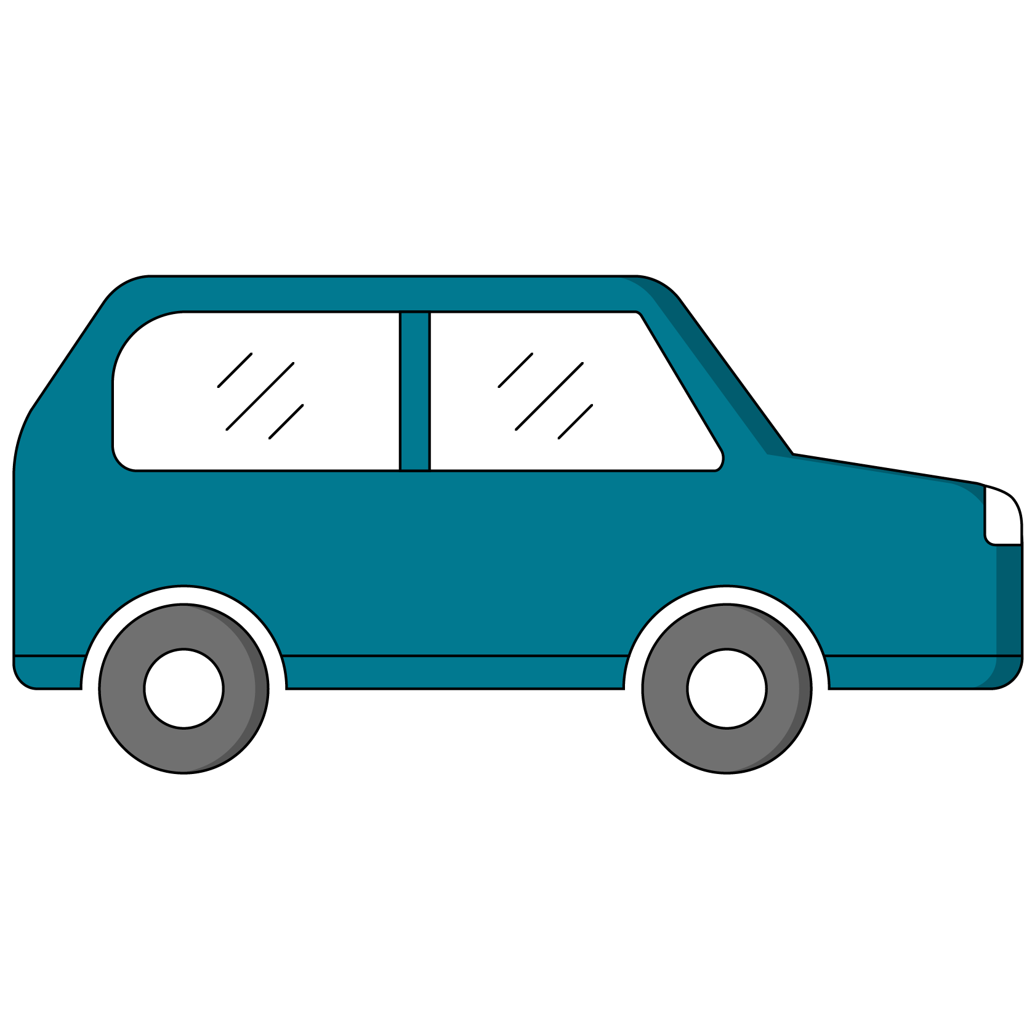
CSS Transforms
You can also adjust the shape and position of elements with transform. It’s not required to do animation, but it is the easiest way to move things fluidly.
You can do a lot with transform — CSS Tricks has great documentation, as usual!

Slide 22

Storyboard Keyframes
Complex animations require something akin to pseudocode before digging in.
Step 1 (0%):
Box top, left
Step 2 (50%):
Box top, right
Step 3 (100%):
Box bottom, right

Slide 23
Animations Practice
30 minutes
With a partner, practice applying these CSS properties in this CodePen.
Starter code:
https://drive.google.com/drive/folders/1qBCQDTRO19yhwyQ7KKJPaZXGjIuKpcFD?usp=sharing
Solution code:
https://drive.google.com/drive/folders/1F_wy4smd29cLW2bcMw4Gnd221kr0ImR8?usp=sharing
‹#› | © 2020 General Assembly

Slide 25
Advanced Animation Resources
Charts.js: good enough charts/graphs
D3: a popular data visualization tool
GSAP: a keyframe animation toolkit

